Slide 1
chaperOne -Caring the blind
By:
Eshwar Prasad B (4AD15CS021)
Manasa R
(4AD15CS043)
ManjuMallika N
(4AD15CS044)
Rudresh RM
(4AD15CS059)
Under the guidance of:
Mrs. Archana MR
Assistant professor
Dept of CSE
ATMECE, Mysuru

Slide 2
Introduction
There are 37 million people across the globe who are blind, over 15 million are from India.
They face difficulties in walking and to do their chores.
chaperOne is a device which guides and allows blind and visually impaired people to live independently without taking any manual guide or help.

Slide 3
System specification
Hardware Requirements
Raspberry pi.
Ultra Sonic Sensor .
Pi Camera.
Earphone.
Battery.
Software Requirements
Domain: Machine Learning, Image processing
Language used: Python.

Slide 4
Methodology

Slide 5

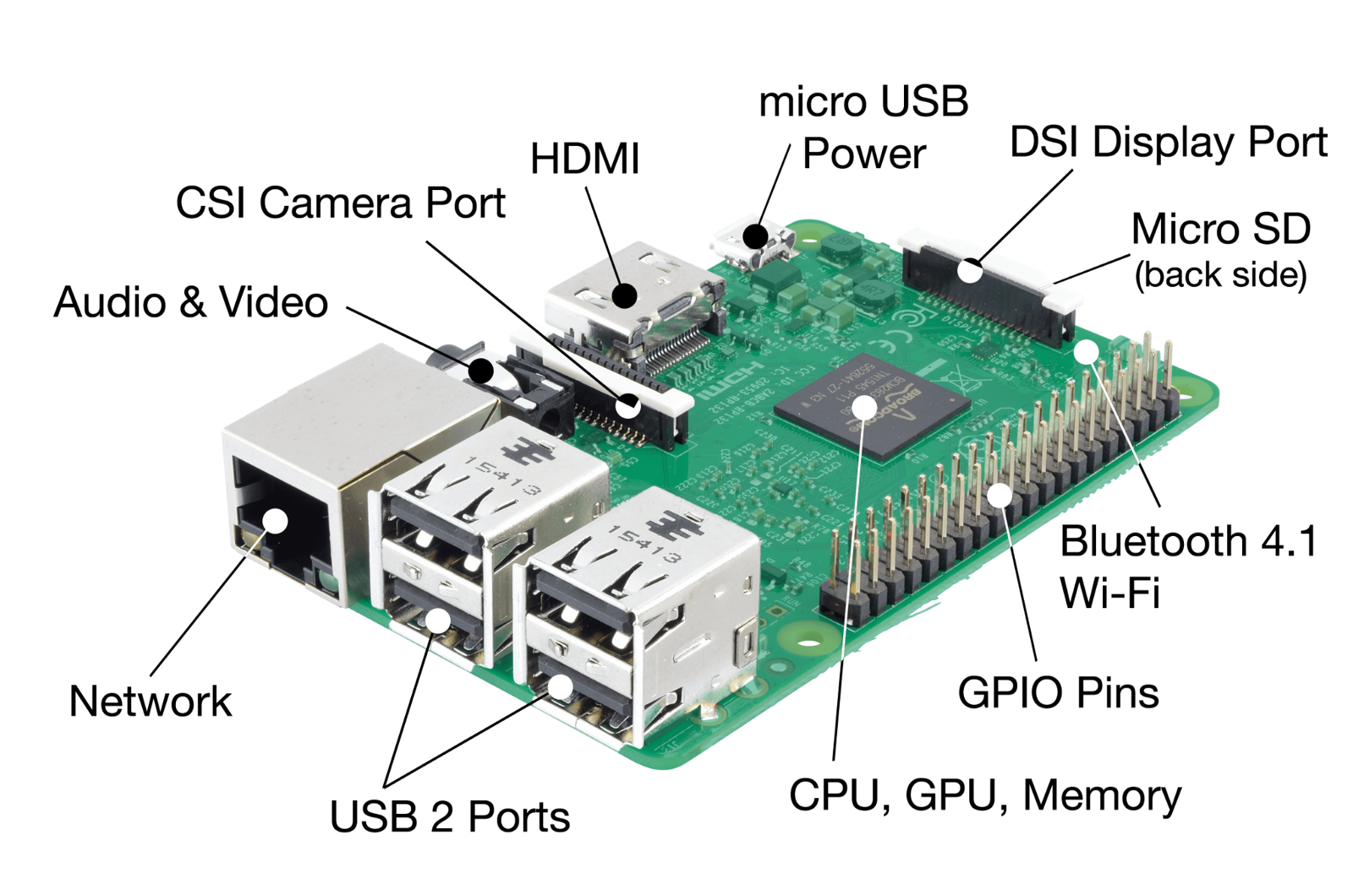
Raspberry pi 3 Model B

Slide 6
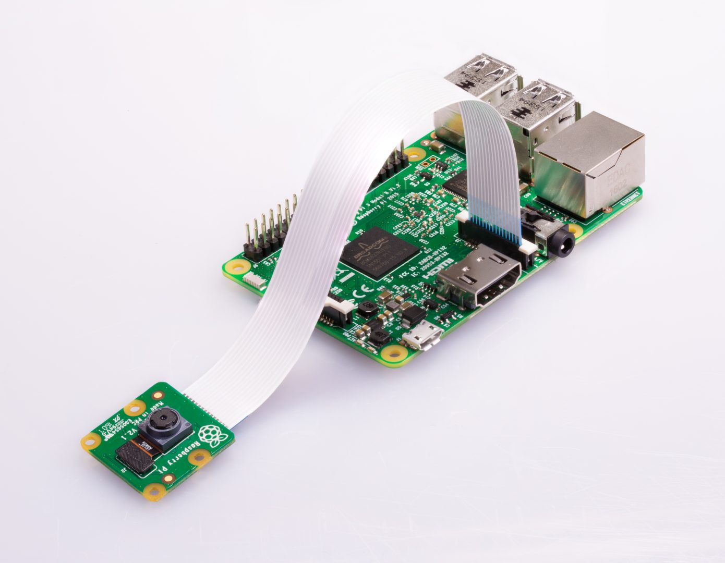
Raspberry pi camera module

Slide 7
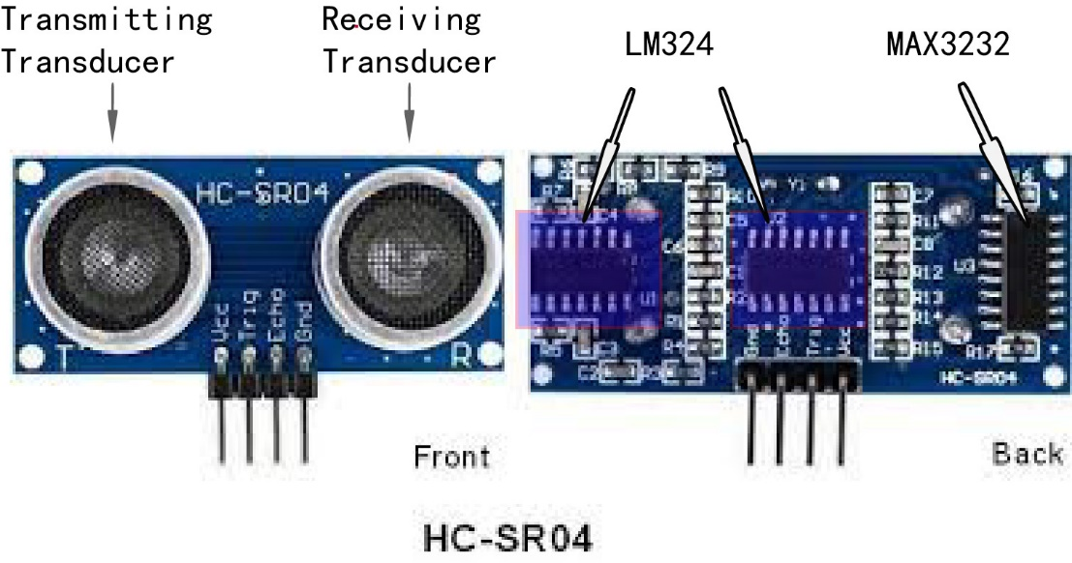
Ultra sonic sensor

Slide 8
Object detection
Algorithm used: YOLO (You Only Look Once)
Advantages:
Speed (45 frames per second — better than real time)
Network understands generalized object representation (This allowed them to train the network on real world images and predictions on artwork was still fairly accurate).
faster version (with smaller architecture) — 155 frames per sec but is less accurate.

Slide 9
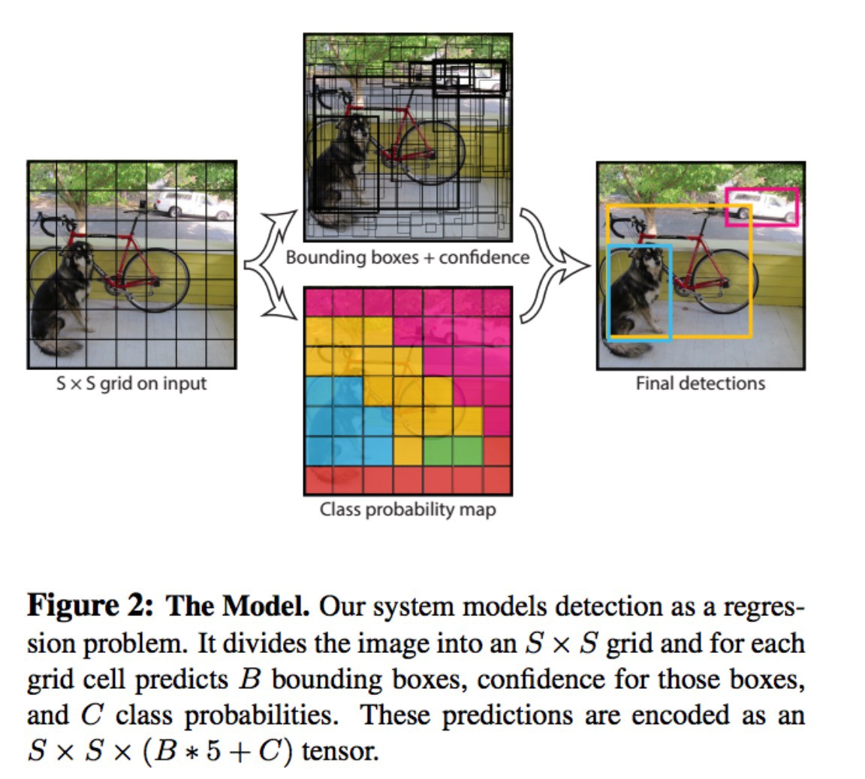

Slide 10
Compared to other region proposal classification networks (fast RCNN) which perform detection on various region proposals and thus end up performing prediction multiple times for various regions in a image, Yolo architecture is more like FCNN (fully convolutional neural network) and passes the image (nxn) once through the FCNN and output is (mxm) prediction. This the architecture is splitting the input image in mxm grid and for each grid generation 2 bounding boxes and class probabilities for those bounding boxes. Note that bounding box is more likely to be larger than the grid itself.

Slide 11
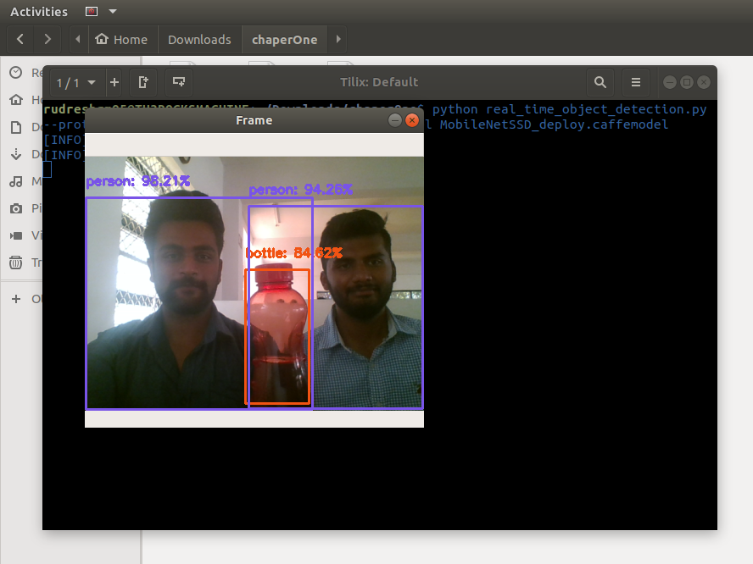

Slide 12
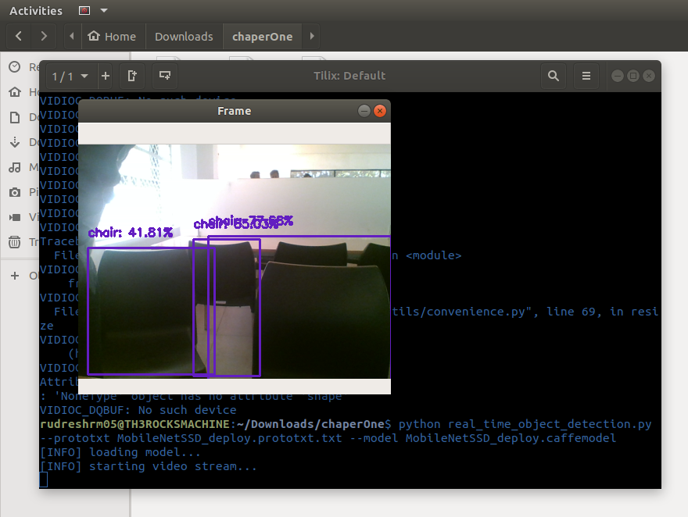

Slide 13


Slide 14
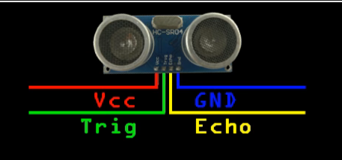
How it works?

Slide 15
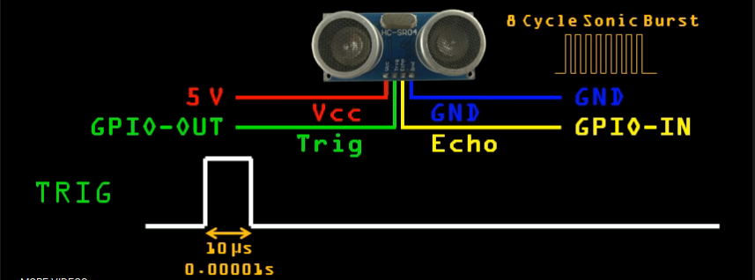

Slide 16
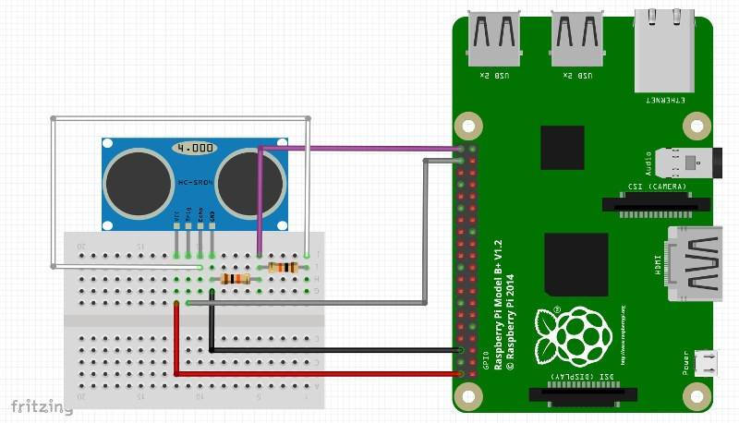

Slide 17
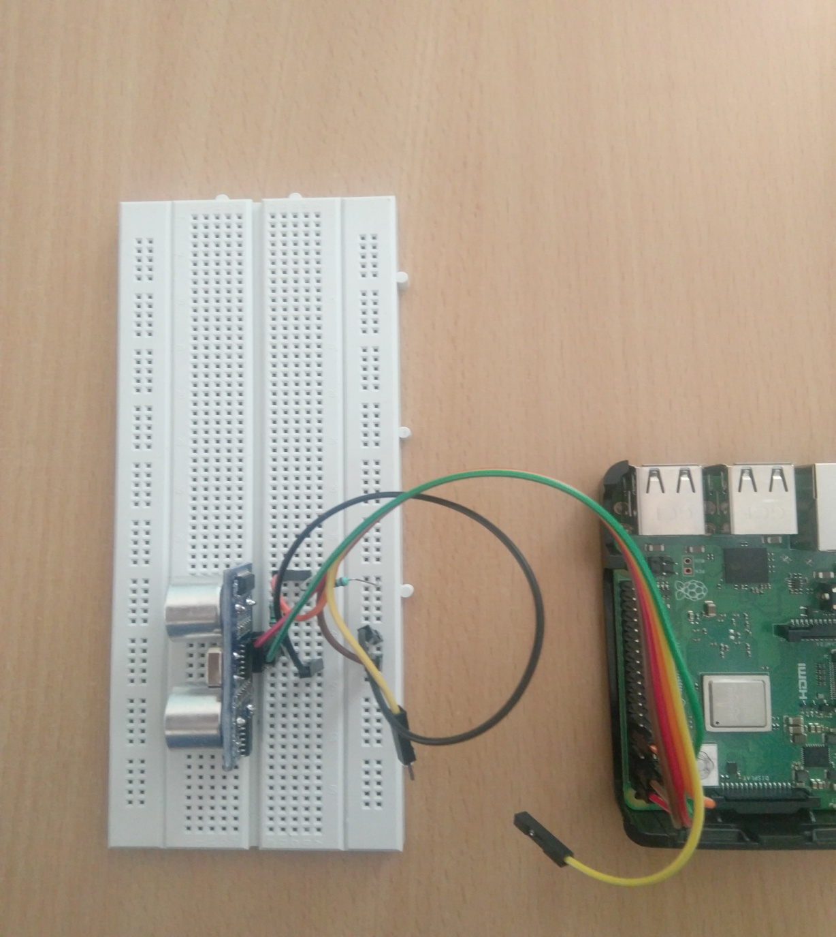

Slide 18
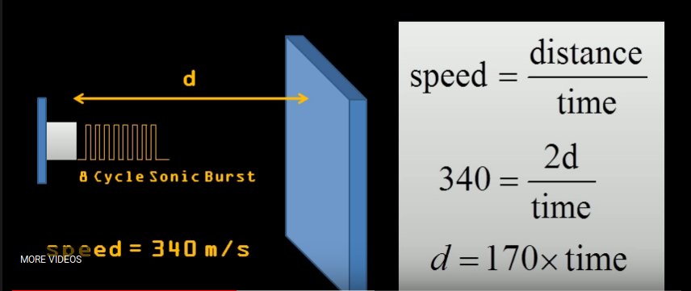
Calculating distance

Slide 19
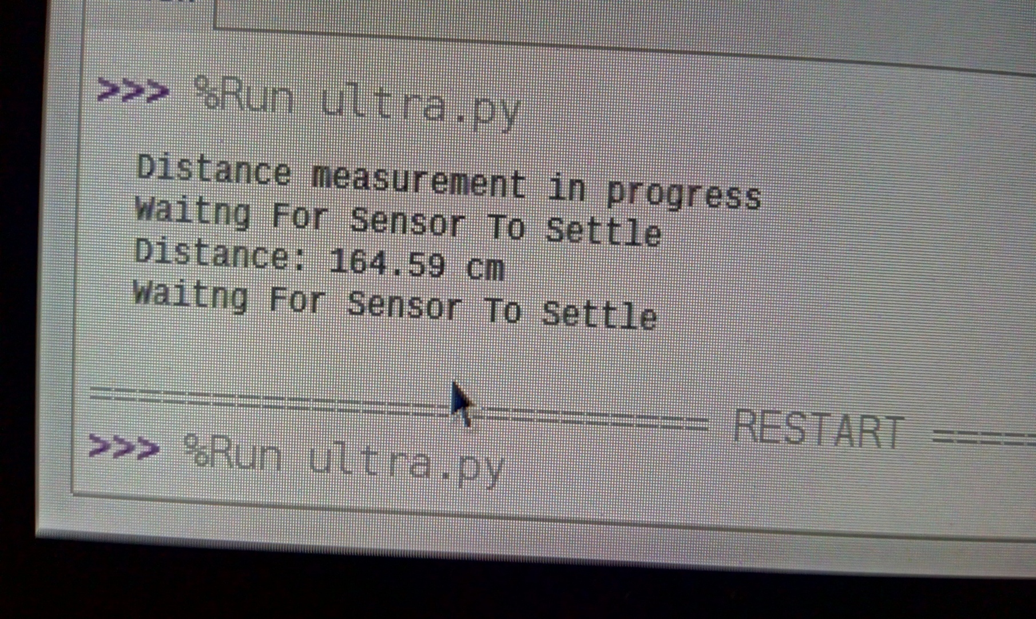

Slide 20
Text to Speech Synthesizer eSpeak
eSpeak is a compact open source software speech synthesizer for English and other languages, for Linux and Windows.
Features:
Includes different Voices, whose characteristics can be altered.
Compact size. The program and its data, including many languages, totals about 2 Mbytes.
Written in C.

Slide 21
Available Languages:
Afrikaans, Albanian, Aragonese, Armenian, Bulgarian, Cantonese, Catalan, Croatian, Czech, Danish, Dutch, English, Esperanto, Estonian, Farsi, Finnish, French, Georgian, German, Greek, Hindi, Hungarian, Icelandic, Indonesian, Irish, Italian, Kannada, Kurdish, Latvian, Lithuanian, Lojban, Macedonian, Malaysian, Malayalam, Mandarin, Nepalese, Norwegian, Polish, Portuguese, Punjabi, Romanian, Russian, Serbian, Slovak, Spanish, Swahili, Swedish, Tamil, Turkish, Vietnamese, Welsh.

Slide 22
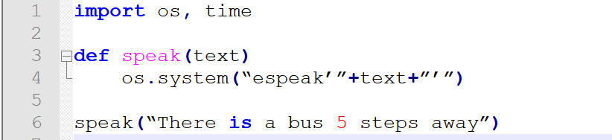
An example code snippet

Slide 23
References
https://towardsdatascience.com/yolo-you-only-look-once-real-time-object-detection-explained-492dc9230006
https://sourceforge.net/projects/espeak/files
https://www.pyimagesearch.com/2017/10/16/raspberry-pi-deep-learning-object-detection-with-opencv

Slide 24
Thank you

